Slide 1
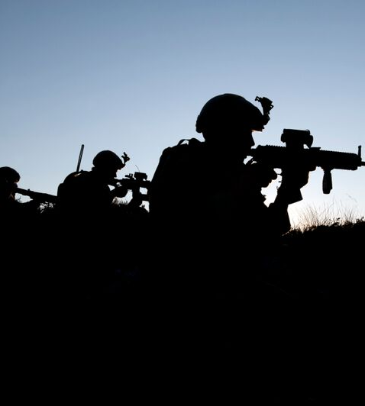



Videre VMS drift

Slide 2






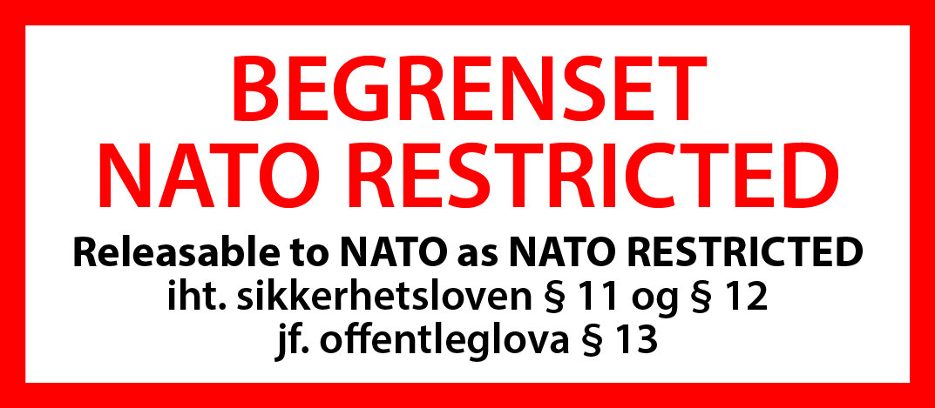
Til 1. lysbildet
Til øvrige lysbilder

Slide 3

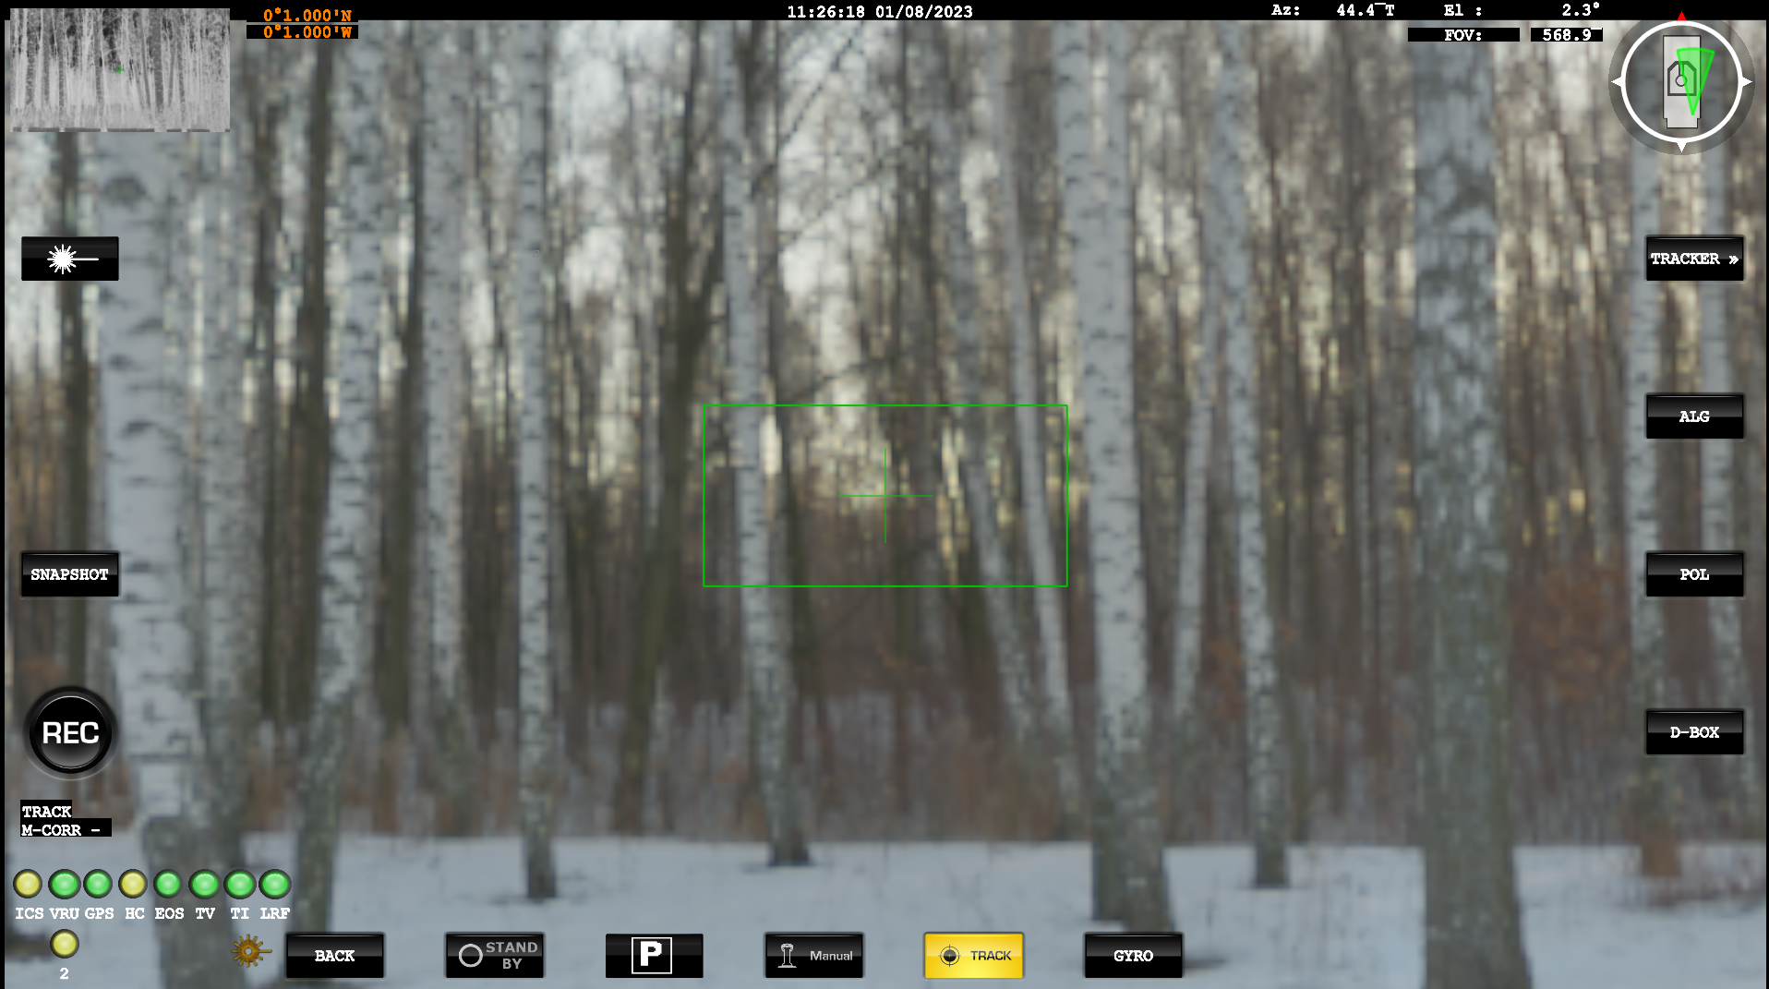

Slide 4
Video tracker
Den automatiske videotrackeren kan benyttes til å ta kontroll over EOD-en og opprettholde visuell track på et valgt mål med primærsensoren
  Det er 3 ulike moduser som kan benyttes
On-screen | Description | Best for
M – Corr (Manual Correlation) | The tracker will track the central area of track window. | Close up images of stationary land targets.
A – Corr (Automatic Correlation) | in manual (acquire target) mode tracker will highlight the closest high contrast ‘blob’ to the boresight. In track mode a pattern matching algorithm will be used to follow the target. | Small targets, larger targets at greater distance.
C-DEFT | Deep Embedded feature tracking. Includes classification | All Items

Slide 5

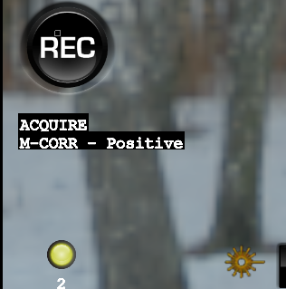
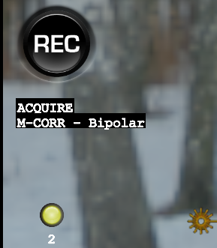
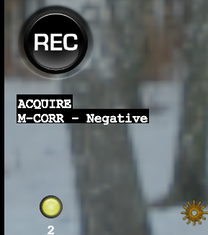
Video tracker
On-screen | Description | Best for
Positive | The video tracker will highlight objects that are brighter than the background. | Targets in the IR camera which are hotter than the background.
Negative | The video tracker will highlight objects that are darker than the background. | Targets in the IR camera which are cooler than the background.
Bipolar | The video tracker will highlight objects that are brighter or darker than the background. | Targets in the TV camera.

Slide 6

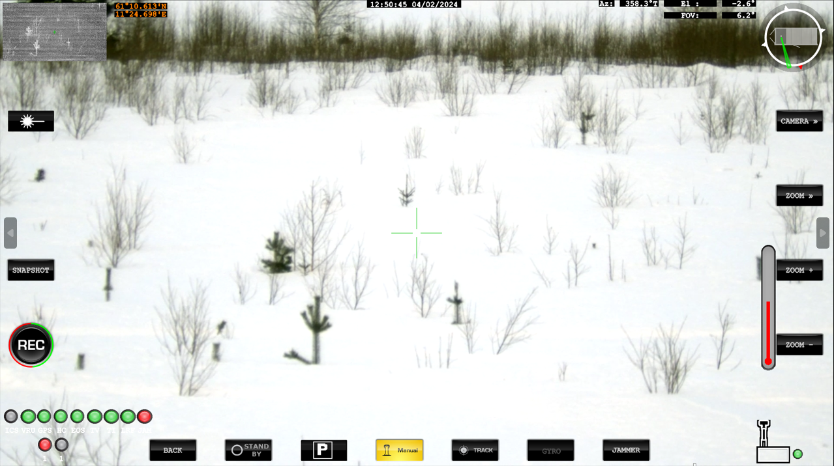


Button | Action | Description
 | Tracking algorithm | Cycles between the centroid and correlation tracking algorithms. The current tracking algorithm is displayed through on-screen symbology.
 | Gate size | Changes the size of the video tracker gate in manual (acquire target) mode. The size of the gate should match that of the target.
 | Track polarity | Selects the polarity of the target highlighted by the video tracker. Current polarity is shown in the on-screen symbology and can be switched between “Positive”, “Negative” and “Bipolar”.

Slide 7
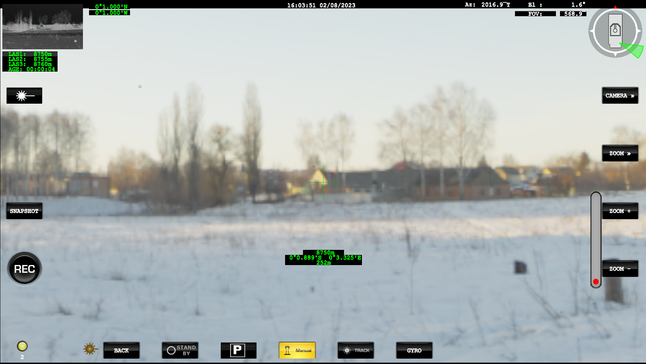
LRF – Laser avstandsmåler
Notes:
On the Screen it will show the Lat/Long and Distance to Target, along with Relative height.
This is all based on Data from the GNSS and IMU information.
This shows the Last 3 returns and the “age” ie when the last measurement was taken.

Slide 8


Opptak av video
Programvaren kan ta opptak av både TV og IR kameraet. Den tar opp begge kameraene automatisk.
Det er plass til minimum 20 timer opptak for begge kameraene.
Trykk på Record for å starte et opptak. Den vil da bli rød når den tar opp
Trykk på Record en gang til for å avslutte opptaket.
Opptaket lagres automatisk på PC-en og du finner de ved høyreklikk på Record-knappen

Slide 9
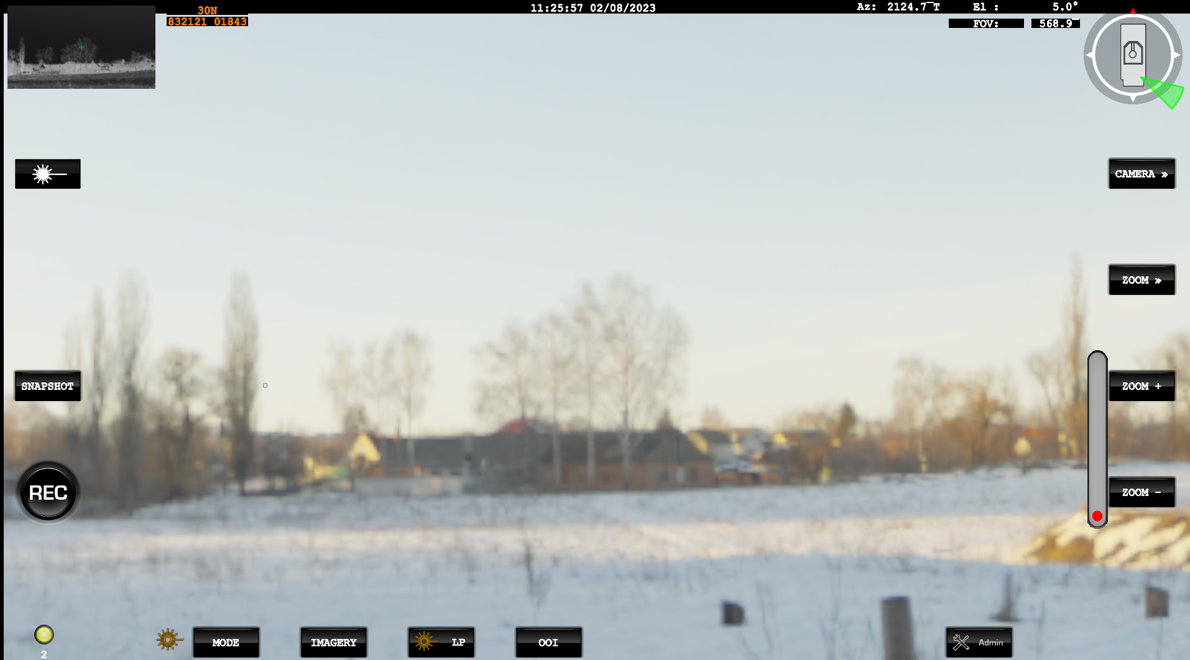
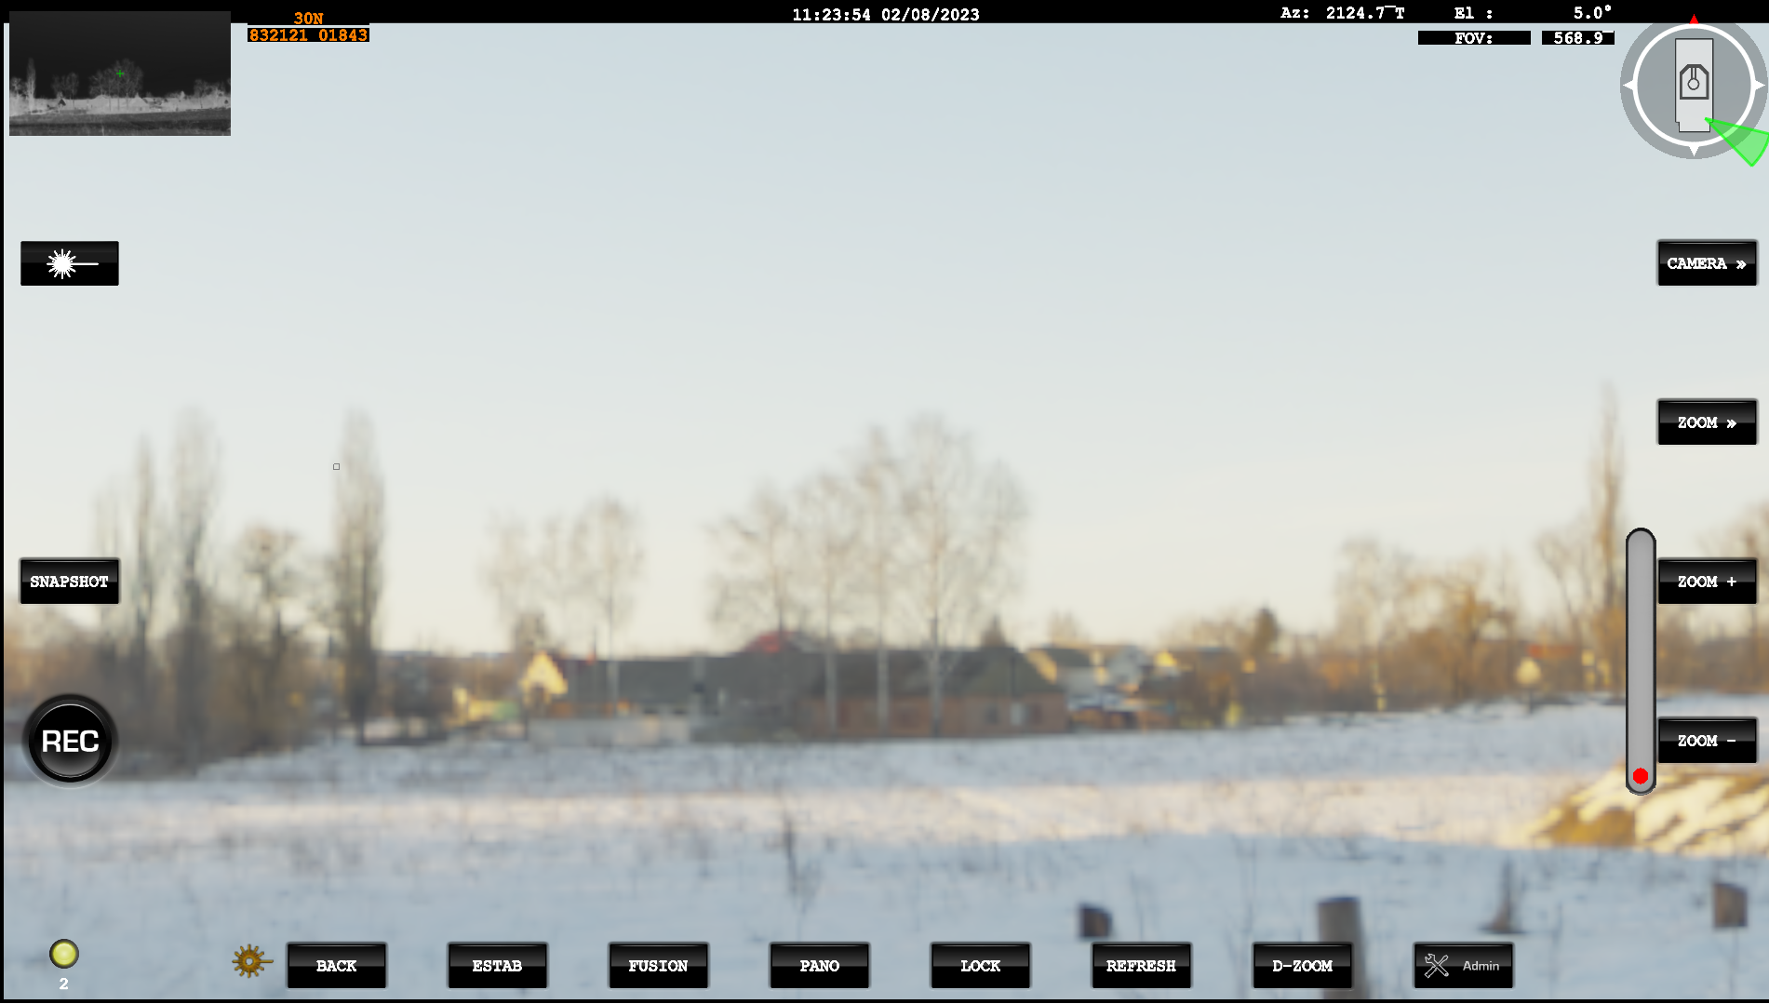
Bilde

Slide 10






Button | Action | Description
 | Enable / Disable Estab | Electronic Stabilisation , it will provide a more stable image against small vibrations.
 | Image Fusion | When ON, the video displayed will be a fusion of the daylight TV and TI camera video.
 | Create Panorama | If a Panorama exists, then it will switch the Display On/Off. If no panorama has been created since boot, then a new panorama will be created.
 | Refresh Panorama | Following on from above. If Panorama is on, this will create a new one utilising the camera that is currently in use as primary sensor.
Button | Action | Description
 | Lock | When the Pano image is unlocked it will move with the cameras as it rotates. When locked, box showing the camera position will stop as it reaches the end of the image and the image will no longer match the camera viewpoint.
 | D-Zoom | This will cycle through the available Digital zoom Levels.

Slide 11
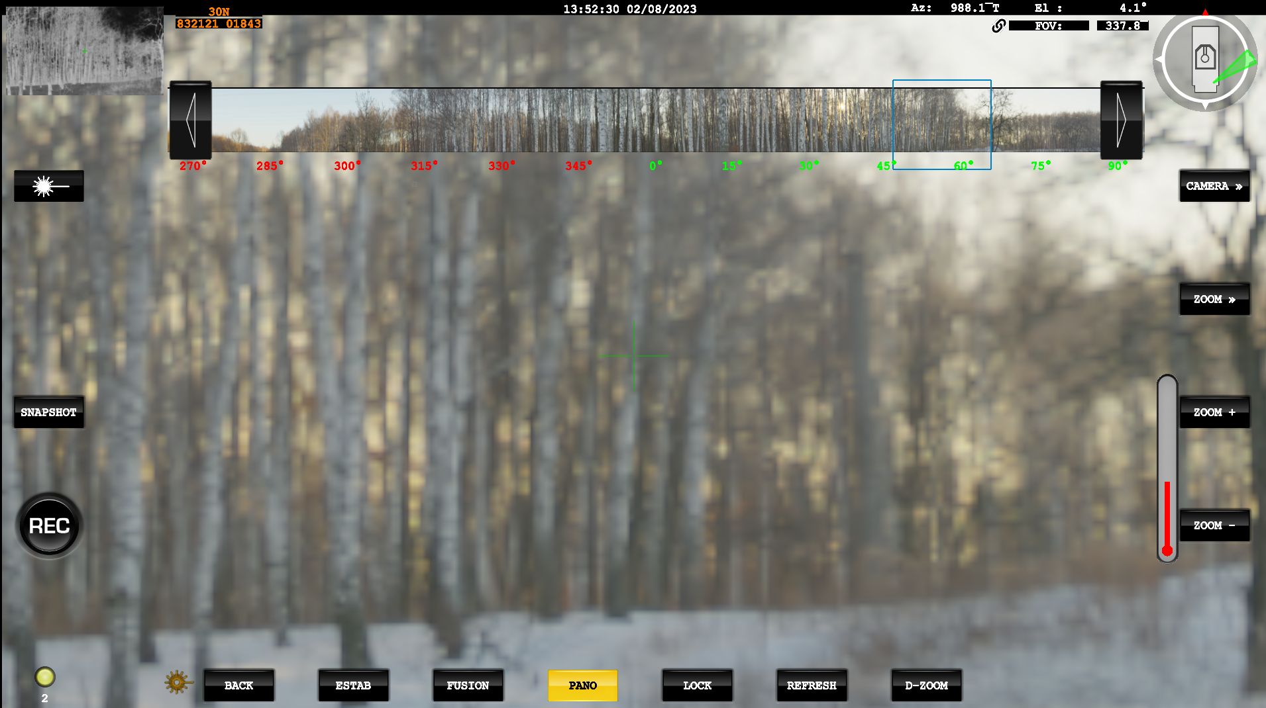
Panorama
Notes:
Yellow Pano button at the bottom indicates that the image is enabled.
Blue Box indicates where the System is currently looking, where this is unlocked, the Panorama will not move with the EOD.
Therefore this blue box, may not always be visible in the Panaorama strip.
When Locked, this Blue box should always be visible in the Stip Image

Slide 12
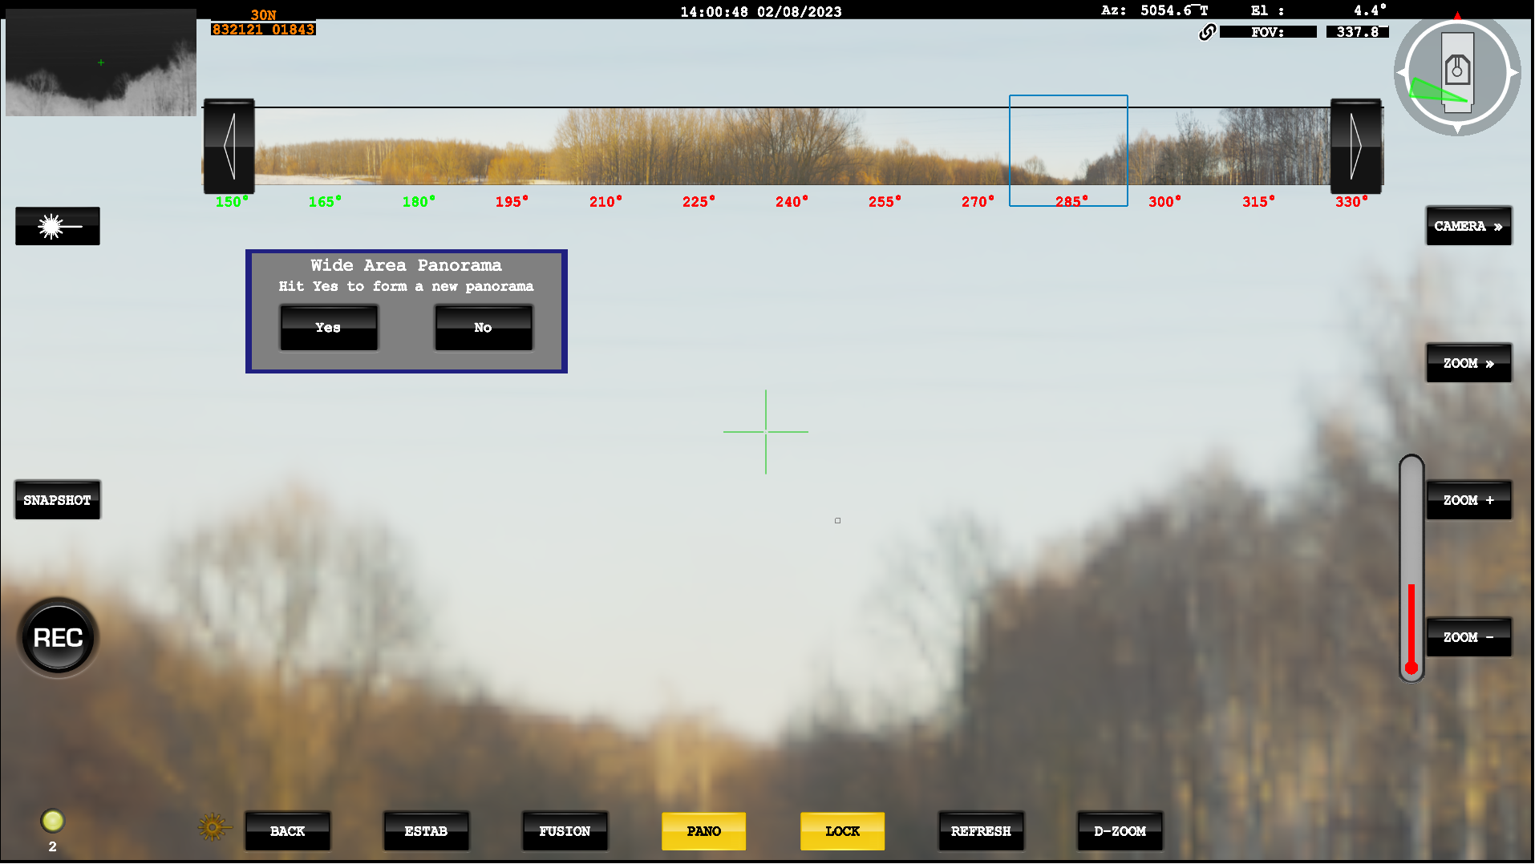
Panorama
Notes:
If Refresh is selected, then a prompt will appear to ask if you wish to create a new Panaorama.
A Right Mouse click on the strip image it’s self has the same effect.
Selecting “Yes” the system will create a new Pano from the current Primary Sensor.
If the Pano is switched off, then the system will save the last strip image created. This will be lost on a reboot. There is an option to save the Panorama formed and can be reloaded.

Slide 13
Panorama
Du kan lagre panorama på systemet. Dersom du restarter systemet uten å lagre panoramet vil det være borte

